Slide 1
A Natural Language Processing Analysis of Sustainability Reports and its Relationship with Corporate Financial Performance: Empirical Evidence from Singapore’s Listed Companies
Jeremy Chia
ESCP Business School
MSc Big Data and Business Analytics, 2021/2022
Supervised by:
Associate Professor Man Ching Gladie LUI
ESCP Business School
Financial Reporting & Audit

Slide 2
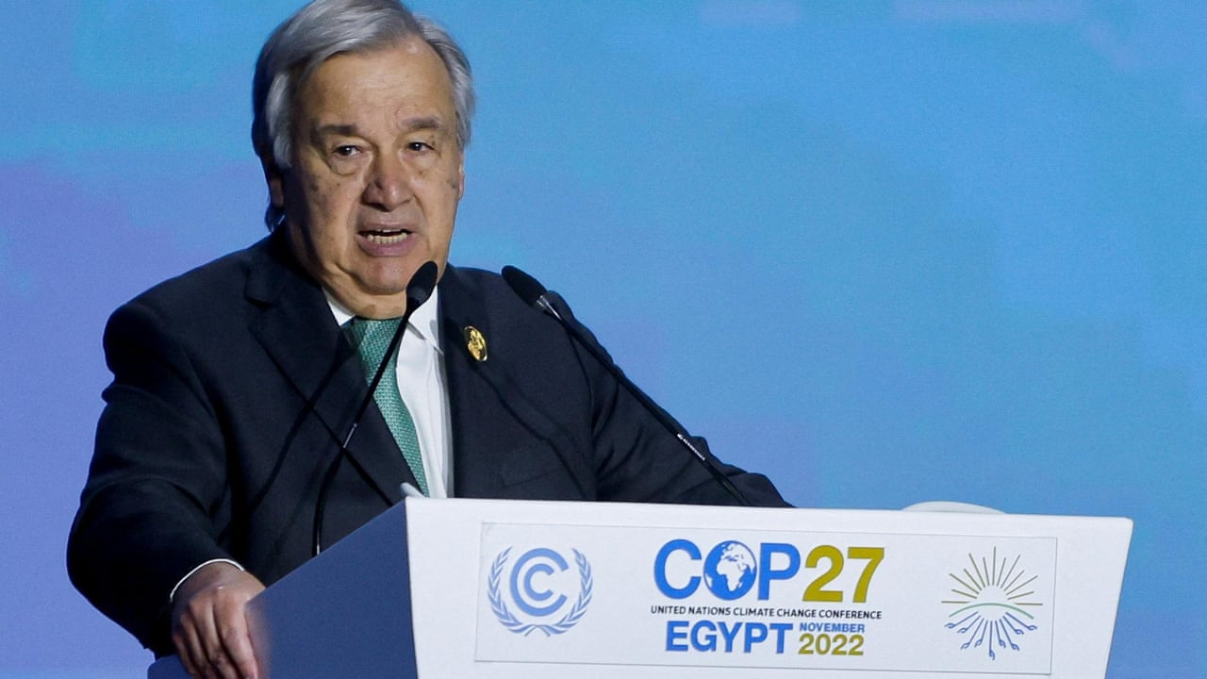

We are in the fight of our lives, and we are losing … And our planet is fast approaching tipping points that will make climate chaos irreversible. “We are on a highway to climate hell with our foot on the accelerator.”
António Guterres
Secretary-General of the United Nations
Nov 7, 2022
Notes:
Reference: https://www.theguardian.com/environment/2022/nov/07/cop27-climate-summit-un-secretary-general-antonio-Guterres

Slide 3
An Overview
What is this study about?
Evolving expectations of
Stakeholders
Leads to
CSR*, ESG*, Sustainability
Actions
Conceptual Frameworks and Theories
Financial Performance
Disclosed in
Sustainability Reports
Using sustainability reporting standards, gradually required by regulators
Using models to understand the relationship
* CSR: Corporate Social Responsibility
* ESG: Environmental, Social, and Governance
Notes:
Introduction – Explain the need for this study

Slide 4
History of Corporate Social Responsibility
How have attitudes towards CSR changed?
2000s: "Doing good" became a competitive advantage as potential investors began to view ESG initiatives as essential factors (Vibert, 2019).
Change of "CSR from being a minimal commitment to becoming a strategic necessity, which can translate into a sustainable competitive advantage." (Warther & Chandler, 2005).
1960s: CSR was a response to labour-management conflict. (Jenkins, 2009)
There have been calls for responsible actions by companies concerning social aspects (Gomez-Carrasco et al., 2016).
1980s: The goal of CSR policy morphed to focus on improving companies' image and reputation and securing social justification to practice (Carrol, 2008).
1970s: era of "managing corporate social responsibility" (Carroll, 2015).
1990s: institutionalisation of CSR. The emerging view was that corporate ethical behaviour would increase corporate competitiveness by establishing sustainable and productive relationships with stakeholders (Jones, 1995).
2010s: Acceleration of institutionalisation of CSR.
More standard-setting bodies emerged for comparability. Porter and Kramar (2011) propose that – "the purpose of the corporation must be redefined as creating shared value".
Notes:
Introduction – Explain the need for this study

Slide 5
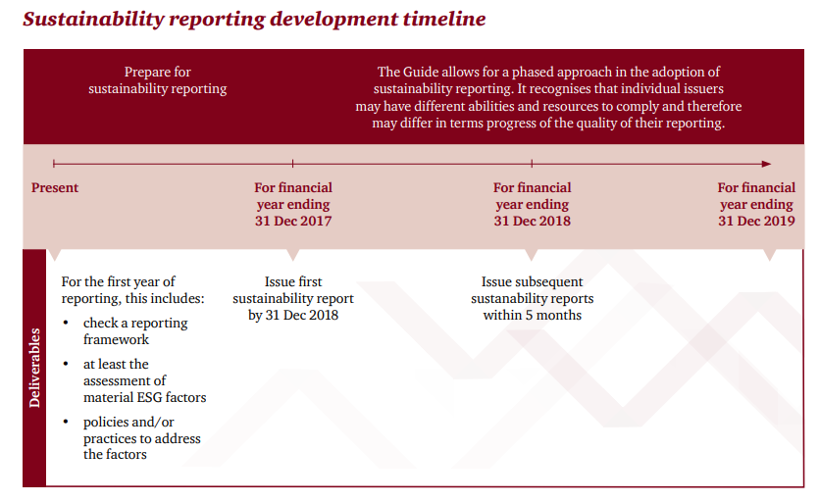
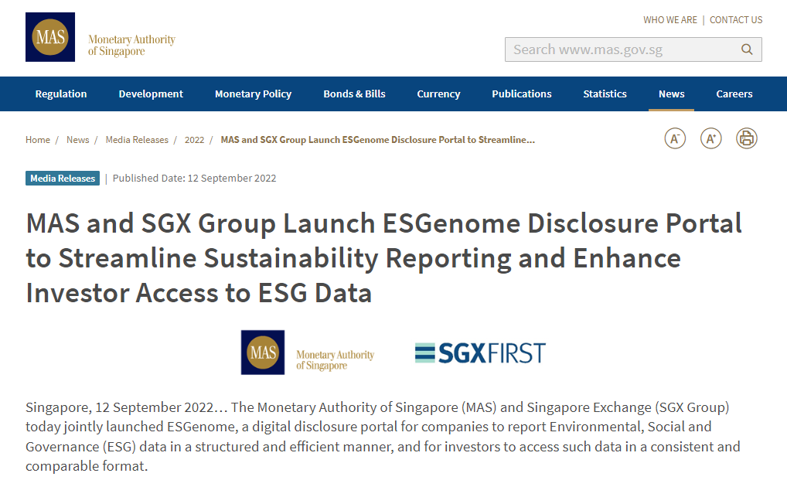
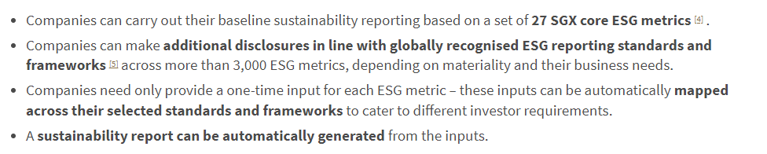


Singapore, Companies, and Disclosures
What were some recent sustainability-related developments in Singapore?
Timeline for initial launch of sustainability reporting requirements in Singapore (PwC, 2016)
Launch of a tool for easier sustainability reporting (MAS, 2022)
Notes:
Introduction – Explain the need for this study

Slide 6
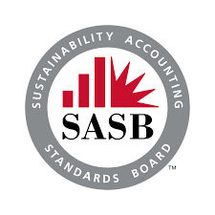


Sustainability Reporting Standards
How may sustainability disclosures be standardised?
New sustainability reporting standards proposed by the IFRS Foundation – exposure drafts for standards IFRS S1 and IFRS S2 were released in mid-2022.
Governance (IFRS S1:11a, 12-13): Providing disclosures on processes, controls, and procedures used to monitor and manage sustainability-related risks and opportunities.
Strategy (IFRS S1:11b, 14-24): Company’s strategy for addressing significant sustainability-related risks and opportunities and the effects of significant sustainability-related risks and opportunities on the financial position, financial performance, and cash flows.
Risk management (IFRS S1:11c, 25-26): The process by which sustainability-related risks and opportunities are identified, assessed, and managed.
Metrics and targets (IFRS S1:11d, 27-35): How the entity measures, monitors, and manages its significant sustainability-related risks and opportunities.
 | GRI | IIRC | SASB | SDG | TCFD
Indonesia | 93% | 4% | 16% | 93% | 5%
Malaysia | 73% | 35% | 11% | 74% | 19%
Philippines | 82% | 17% | 35% | 86% | 38%
Singapore | 99% | 8% | 10% | 65% | 18%
Thailand | 89% | 13% | 10% | 95% | 27%
Vietnam | 65% | 8% | 2% | 42% | 0%
Adoption of Various Sustainability Reporting Frameworks for Listed Companies in Reports issued for Financial Periods ending in 2021 (GRI and NUS, 2022)
Notes:
Introduction – Explain the need for this study

Slide 7
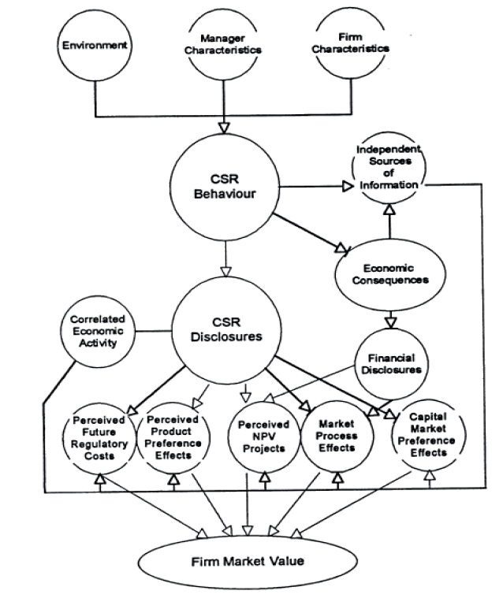
Theories in CSR* and CFP*
How may these two aspects of companies’ be related?
Legitimacy theory: Companies need to act in congruence with society to uphold their business activities. (O’Donovan, 2002).
Stakeholder theory: This suggests that firms accede to the needs of stakeholders – more than merely the needs of shareholders (Ruf et al., 2001) – because of stakeholders’ expectations of a firm.
Signalling theory: CSR activities and ESG management can also be seen as a type of signal companies send to their stakeholders (Backhaus et al., 2002). People can react to a firm’s CSR investment by seeking employment with the firm instead of just purchasing its products. (Greening and Turban, 2000).
Resource theories: a company’s internal resources decide the source of corporate competitive advantage (McWilliams and Siegel, 2011).
Transaction cost economics: firms with good CSR perceptions have low-cost implicit claims (Cornell and Shapiro, 1987; Peloza, 2006) for lower risks involved.
A model of the capital market impacts of corporate social responsibility (Richardson et al., 1999)
* CSR: Corporate Social Responsibility
* CFP: Corporate Financial Performance
Notes:
Literature review – Explain what other scholars have found on the subject

Slide 8
Prior Approaches
How was this topic studied previously?
Explanatory Variables
Target Variables
Models Used
Loh et al. (2017) used a measurement scheme developed by the ASEAN CSR Network, which proposes 23 criteria in the scheme over governance, economic, environmental, and social indicators.
Wahyuningrum et al. (2021) used an abridged form of content analysis to assign scores based on the number of disclosures – the number of sentences and the number of pages.
Aggarwal (2013) used scores extracted from private databases.
Financial metrics used were based on generally-available information.
Return on Assets (ROA), Return on Equity (ROE), and Profit before Tax (PBT), employed in several studies (Aggarwal, 2013; Ching et al., 2017; Kasbun et al., 2016)
Rodgers et al. (2013) and Rodgers et al. (2017) used the Zmijewski score (Zmijewski, 1984) as a proxy for financial viability.
Some studies chose to regress listed firms at a point in time to determine if more disclosures in the year had a positive relationship with financial performance (Kasbun et al., 2017; Aggarwal, 2013; Motwani and Pandya, 2016; Ching et al., 2017; Jones et al., 2007).
Others conducted a longitudinal study comparing companies’ performance across years (Tsang, 1998; Wahyuningrum et al., 2021).
Loh et al. (2017) used the Ohlson model (Ohlson, 1995) as a baseline model.
Notes:
Literature review – Explain what other scholars have found on the subject

Slide 9
Research Questions
What are the questions this study proposes to address?
What are the most prominent topics in sustainability reports from an exploratory topic modelling analysis? Will this resemble the disclosure themes in frameworks like the Global Reporting Initiative?
How do these topics identified in RQ 1 relate to corporate financial performance (CFP)?
How do a sustainability report's readability and sentiment score relate to corporate financial performance?
Are there material differences in the relationship between CSR disclosures and CFP at this point, vis-à-vis prior studies conducted by Tsang, 1998 and Loh et al., 2017?
Notes:
Research methodology – What research method did you use, and why did you use it?

Slide 10


Data Sources and Methodology
How will the research questions be answered?
Explanatory Variables
Financials from Bloomberg Terminal
Target Variables
Sustainability Reports from SGX
Component companies of the STI
(with pre-
processing,
NLP applied)
OLS Regression
Ohlson’s Model
Topics ($k=7$) [RQ1,2]
Return on Assets
Sentiment [RQ 3]
Market Value $(t+4)$
Readability [RQ 3]
Zmijewski Score
Compared with prior studies [RQ 4]
Notes:
Research methodology – What research method did you use, and why did you use it?

Slide 11
Textual Pre-processing
What were the textual pre-processing steps applied to sustainability reports?
Tokenisation
Lemmatisation
Stop Word Removal
Splitting text in sustainability reports into units for analysis – each token is one word.
For topic modelling, grouping words together based on their inflected forms using the default English lemmatisation list (Měchura, 2016).
For example, ‘runs’, ‘running’, ‘ran’ are all forms of the word ‘run’, therefore run is the lemma of all these words.
Preferred over stemming, because lemmatising produces more interpretable words.
For topic modelling, to remove non-meaningful words which do not value-add to the results (i.e. stop words).
Used stop word dictionaries provided by Lewis et al. (2004) and Feinerer et al. (2008) to remove stop words.
Proposed removing other stop words:
Original Text: “The reduction of total water consumption and overall water intensity are also key sustainability goals of the Manager.” As Tokens: “The”, “reduction”, “of”, “total”, “water”, “consumption”, “and”, “overall”, “water”, “intensity”, “are”, “also”, “key”, “sustainability”, “goals”, “of”, “the”, “Manager”. (Extracted from Page 41 of Ascendas REIT’s 2019 Sustainability Report)
Category | Words
Company | ‘singtel’, ‘wilmar’, ‘cdl’, ‘sia’
Country | ‘singapore’, ‘taiwan’, ‘thailand’
Websites | ‘www’, ‘com’
Notes:
Research methodology – What research method did you use, and why did you use it?

Slide 12
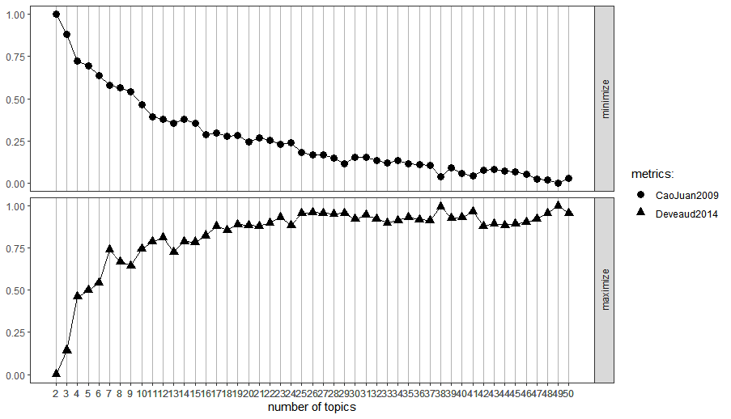

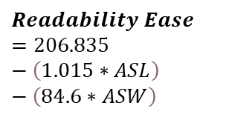
Explanatory Variables
What factors are considered for sustainability reports?
Topics ($k=7$)
Sentiment
Readability
[RQ1]
(Flesch, 1948)
Determining the key themes in all sustainability reports using Latent Dirichlet allocation.
Optimising for the number of topics – balancing between separation and interpretability. (Cao et al., 2009 and Deveaud et al., 2014)
Measuring the sentiment of sustainability reports using lexicons.
Taking the arithmetic average of the following lexicons: AFINN, NRC, Bing, Jockers (General), Loughran (Jockers) as a gauge.
Each report is given a sentiment score.
Obfuscation hypothesis (Rutherford, 2003): companies make unfavourable to decode using more positive language.
Flesch Reading Ease Score, a classical readability measure will be used.
Longer sentence lengths (ASL) and syllables per words (ASW) decrease the readability.
Each report is given a readability score.
$$Readability Ease=206.835−\left(1.015∗ASL\right)−\left(84.6∗ASW\right)$$
Notes:
Research methodology – What research method did you use, and why did you use it?

Slide 13
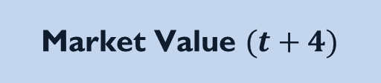
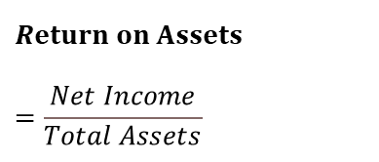
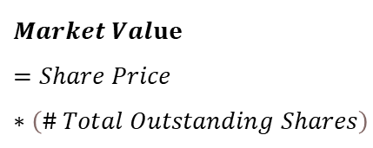
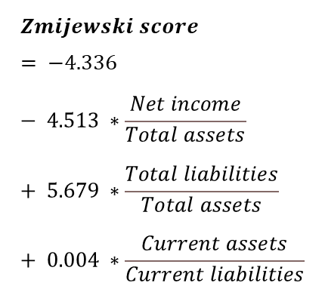
Target Variables
What factors are considered for financial performance?
Return on Assets
Market Value $(t+4)$
Zmijewski Score
(Zmijewski, 1984)
Measure of a company’s ability to use its assets efficiently to generate profits (Wahyuningrum et al., 2021).
Higher ROAs indicate better returns on each investment dollar spent.
Market value fourth months after the disclosure date (Loh et al., 2017).
Investors’ perception of the company’s valuation after disclosure materials were released and considered.
Assesses the company’s risk of bankruptcy based on profitability, solvency, and liquidity (Rodgers, 2017).
Higher scores are indicative of a higher risk of defaults.
$$Return on Assets=\frac{Net Income}{Total Assets}$$
$$Market Value=Share Price∗\left(\# Total Outstanding Shares\right)$$
$$Zmijewski score = −4.336 − 4.513 ∗\frac{Net income}{Total assets} + 5.679 ∗\frac{Total liabilities}{Total assets} + 0.004 ∗\frac{Current assets}{Current liabilities}$$
Notes:
Research methodology – What research method did you use, and why did you use it?

Slide 14
Model and Hypothesis
What was being tested, and how?
[RQ2] - How do the most prominent topics relate to CFP?
OLS
$$ROA_{t}=β_{0}+β_{1}TC_{t,2}+B_{2}TC_{t,2}+…+B_{k}TC_{t,k}+ε$$
OLS
$$ZJS_{t}=β_{0}+β_{1}TC_{t,2}+B_{2}TC_{t,2}+…+B_{k}TC_{t,k}+ε$$
Ohlson’s
$$MV_{t+4}=β_{0}+B_{1}BV_{t}+β_{2}EARN_{t}+β_{3}EARN_{t}∗NEG_{t}+\left(β_{4}TC_{1}+β_{5}TC_{2}+…β_{k+3}TC_{3}\right)+ε$$
[RQ3] - How do a sustainability report's readability and sentiment score relate to CFP?
OLS
$$ROA_{t}=β_{0}+RE_{t}+S_{t}+ε$$
OLS
$$ZJS_{t}=β_{0}+RE_{t}+S_{t}+ε$$
Ohlson’s
$$MV_{t+4}=β_{0}+B_{1}BV_{t}+β_{2}EARN_{t}+β_{3}EARN_{t}∗NEG_{t}+\left(β_{4}RE_{t}+β_{5}S_{t}\right)+ε$$
Notes:
The OLS method aims to minimize the sum of square differences between the observed and predicted values.
The Ohlson’s model (Ohlson, 1995) will be used as a baseline model. The Ohlson’s model was also used in Loh et al. (2017).

Slide 15
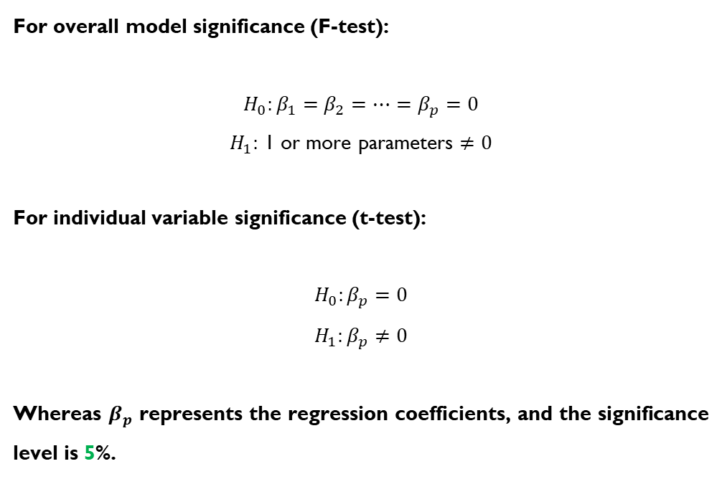
Model and Hypothesis
What was being tested, and how?
For overall model significance (F-test):
$$H_{0}:β_{1}=β_{2}=…=β_{p}=0$$
$H_{1}:$ 1 or more parameters $≠0$
For individual variable significance (t-test):
$$H_{0}:β_{p}=0$$
$$H_{1}:β_{p}≠0$$
Whereas $β_{p}$ represents the regression coefficients, and the significance level is 5%.
Notes:
Research methodology – What research method did you use, and why did you use it?

Slide 16
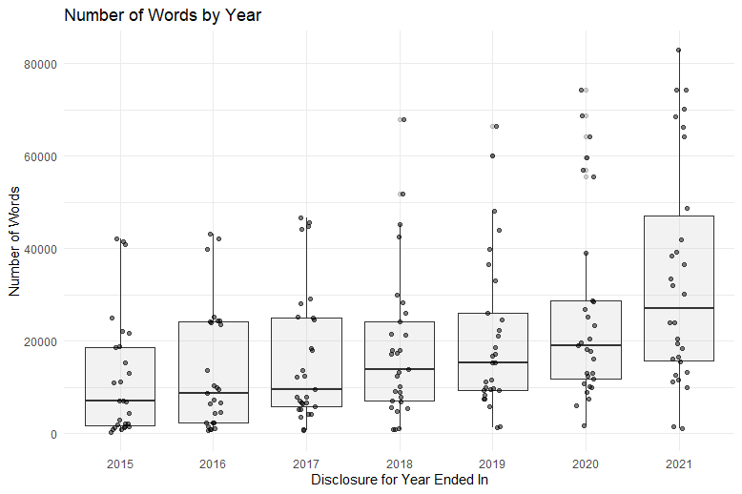
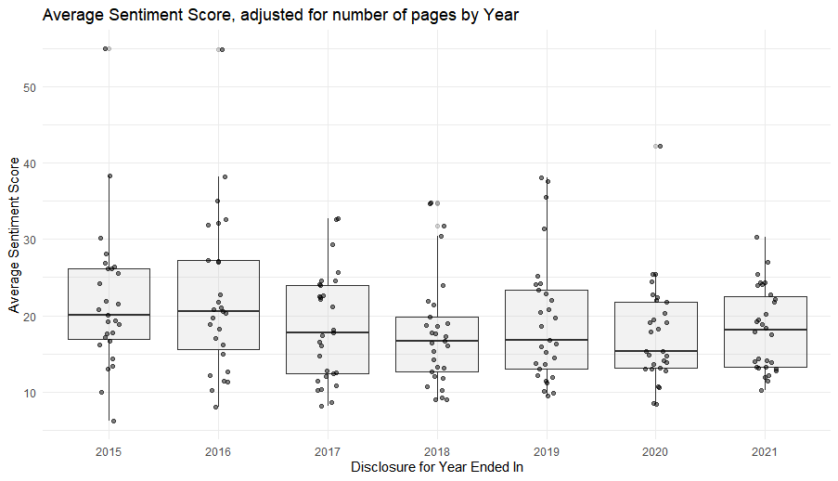
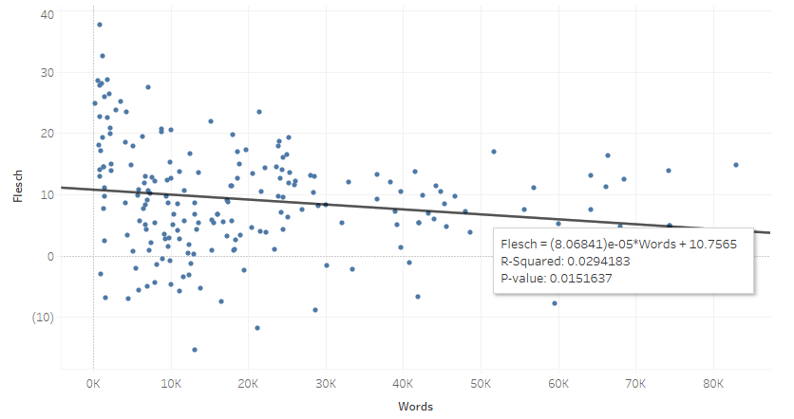
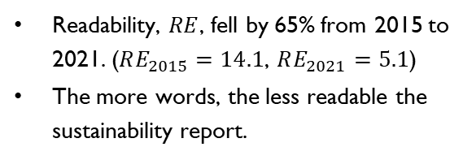
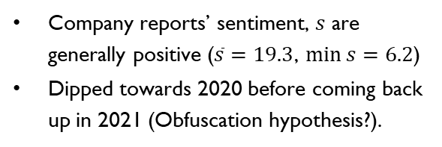
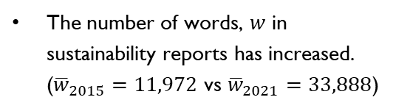
Insights from Exploratory Data Analysis
What were some trends seen from the data?
In the observation period of 2015-2021:
The number of words, $w$ in sustainability reports has increased. (${\overline{w}}_{2015}=11,972$ vs ${\overline{w}}_{2021}=33,888$)
Company reports’ sentiment, $s$ are generally positive ($\overline{s}=19.3$, $\min{s=6.2}$)
Dipped towards 2020 before coming back up in 2021 (Obfuscation hypothesis?).
Readability, $RE$, fell by 65% from 2015 to 2021. ($RE_{2015}=14.1$, $RE_{2021}=5.1$)
The more words, the less readable the sustainability report.
Number of Words:
Sentiment Score:
Readability vs # Words:
Notes:
Findings and discussions – In your research, what were the key deductions that you came upon?

Slide 17
Key Topics
[RQ1]: What are the most prominent topics in sustainability reports?
In the observation period of 2015-2021:
Topic | Theme | Words
1 | Social / Community | Community, Social, Support, Development, Children, Activities
2 | Environment / Resources | Energy, Emissions, Waste, Water, Consumption, GHG
3 | Social / Customers | Customer, Safety, Service, Security, Quality
4 | Social / Employees | Employees, Work, Safety, Development, Training
5 | Methodology | GRI, Material, Assurance, Information, Standards
6 | Governance | Board, Corporate, Governance, Committee, Risk, Policy
7 | Environment / Climate | Climate, Impact, Green, Building
Focus in sustainability reports has shifted from governance to climate disclosures.
Notes:
Findings and discussions – In your research, what were the key deductions that you came upon?

Slide 18
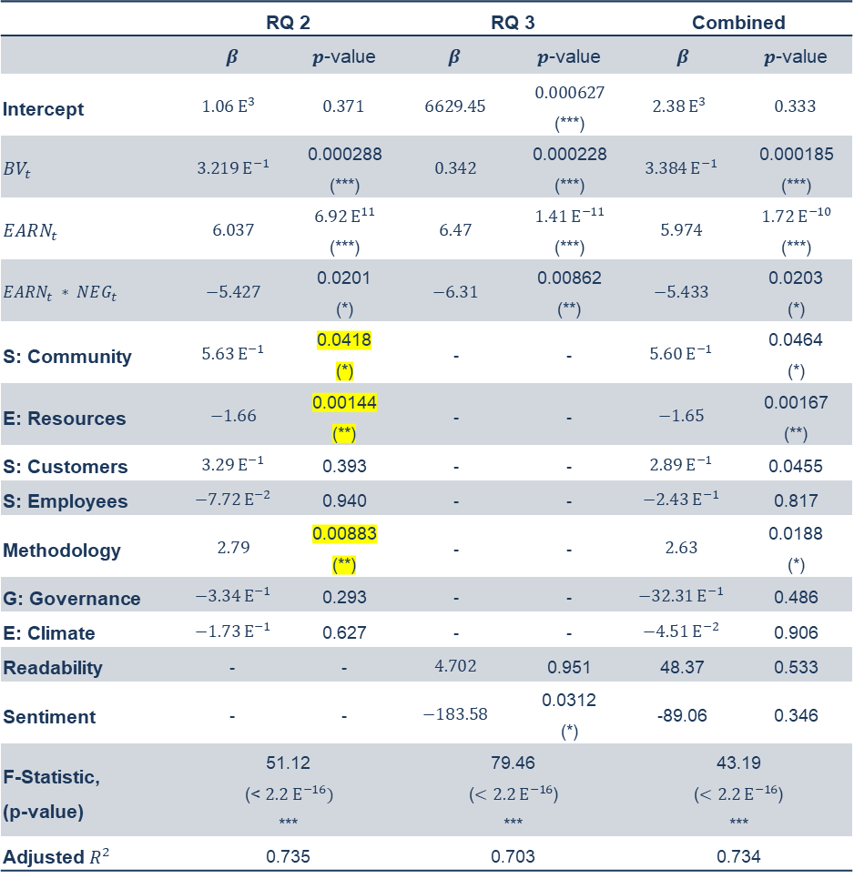
Analysis on Market Value
What is a sustainability report’s influence on the company’s valuation by investors? [RQ2,3]
 | RQ 2 |  | RQ 3 |  | Combined
 | $$β$$ | $p$-value | $$β$$ | $p$-value | $$β$$ | $p$-value
Intercept | $$1.06 Ε^{3}$$ | $$0.371$$ | $$6629.45$$ | $$0.000627$$ (***) | $$2.38 Ε^{3}$$ | $$0.333$$
$$BV_{t}$$ | $$3.219 Ε^{−1}$$ | 0.000288 (***) | $$0.342$$ | 0.000228 (***) | $$3.384 Ε^{−1}$$ | 0.000185 (***)
$$EARN_{t}$$ | $$6.037$$ | $$6.92 Ε^{11}$$ (***) | $$6.47$$ | $$1.41 Ε^{−11}$$ (***) | $$5.974$$ | $$1.72 Ε^{−10}$$ (***)
$$EARN_{t} ∗ NEG_{t}$$ | $$−5.427$$ | 0.0201 (*) | $$−6.31$$ | 0.00862 (**) | $$−5.433$$ | 0.0203 (*)
S: Community | $$5.63 Ε^{−1}$$ | 0.0418 (*) | - | - | $$5.60 Ε^{−1}$$ | 0.0464 (*)
E: Resources | $$−1.66$$ | 0.00144 (**) | - | - | $$−1.65$$ | 0.00167 (**)
S: Customers | $$3.29 Ε^{−1}$$ | 0.393 | - | - | $$2.89 Ε^{−1}$$ | 0.0455
S: Employees | $$−7.72 Ε^{−2}$$ | 0.940 | - | - | $$−2.43 Ε^{−1}$$ | 0.817
Methodology | $$2.79$$ | 0.00883 (**) | - | - | $$2.63$$ | 0.0188 (*)
G: Governance | $$−3.34 Ε^{−1}$$ | 0.293 | - | - | $$−32.31 Ε^{−1}$$ | 0.486
E: Climate | $$−1.73 Ε^{−1}$$ | 0.627 | - | - | $$−4.51 Ε^{−2}$$ | 0.906
Readability | - | - | $$4.702$$ | 0.951 | 48.37 | 0.533
Sentiment | - | - | $$−183.58$$ | 0.0312 (*) | -89.06 | 0.346
F-Statistic, (p-value) | 51.12 (< $2.2 Ε^{−16})$ *** |  | 79.46 ($<2.2 Ε^{−16}$) *** |  | 43.19 ($<2.2 Ε^{−16}$) ***
Adjusted $R^{2}$ | 0.735 |  | 0.703 |  | 0.734
The financial indicators currently still have the most statistically significant influence on investors’ valuation of the company – this validates Ohlson’s model used in Loh et al. (2017),
Understanding this through the legitimacy theory, companies that are more compliant are more positively perceived by investors – evidenced by the impact of the extent of methodology disclosures has.
The relationship on community-related disclosures is supported by the stakeholder theory – in that investors believe that a company which serves its stakeholders is poised to perform well.
Sentiments: The more positive the words used were, the lower the observed market value. This tends towards the view Hrasky (2012) and Boiral (2013) held – more positive words were used when negative events occurred.
Notes:
Findings and discussions – In your research, what were the key deductions that you came upon?

Slide 19
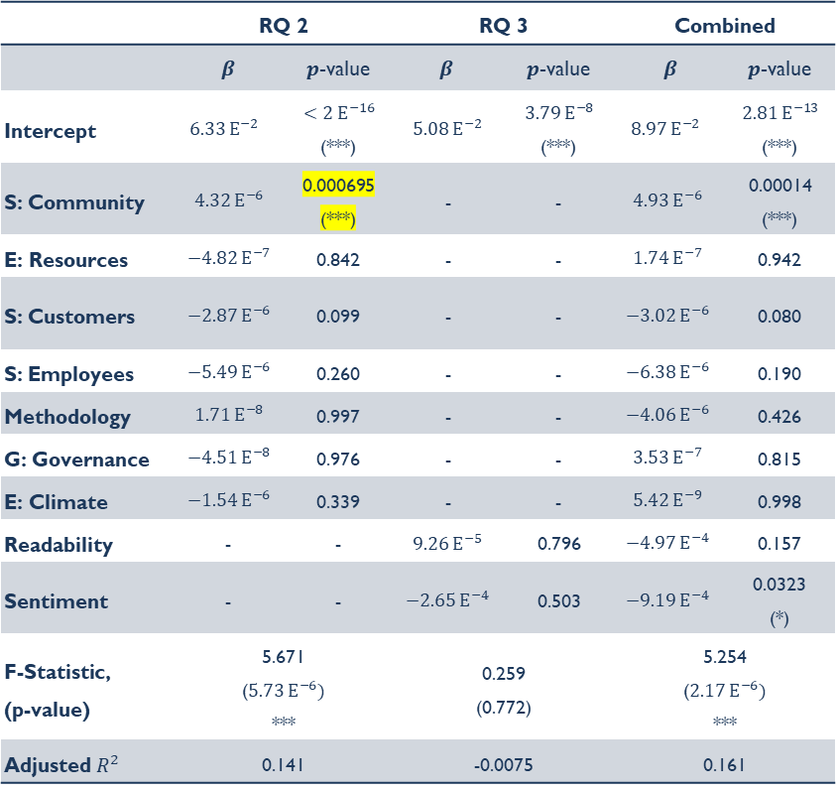
Analysis on Return on Assets
What is a sustainability report’s influence on the company’s profitability? [RQ2,3]
The extent of community-related disclosures, has a positive relationship with the company’s return on assets.
This result supports the legitimacy theory – that companies need to act in congruence with society to uphold their business activities (O’Donovan, 2002).
A sustainability report’s readability and sentiment score does not significantly influence the company’s return on assets.
By extension, the sustainability report, as a communication medium of the company, does not have a statistically significant relationship with the company’s internal operational efficiency
 | RQ 2 |  | RQ 3 |  | Combined
 | $$β$$ | $p$-value | $$β$$ | $p$-value | $$β$$ | $p$-value
Intercept | $$6.33 Ε^{−2}$$ | $$<2 Ε^{−16}$$ (***) | $$5.08 Ε^{−2}$$ | $$3.79 Ε^{−8}$$ (***) | $$8.97 Ε^{−2}$$ | $$2.81 Ε^{−13}$$ (***)
S: Community | $$4.32 Ε^{−6}$$ | 0.000695 (***) | - | - | $$4.93 Ε^{−6}$$ | 0.00014 (***)
E: Resources | $$−4.82 Ε^{−7}$$ | 0.842 | - | - | $$1.74 Ε^{−7}$$ | 0.942
S: Customers | $$−2.87 Ε^{−6}$$ | 0.099 | - | - | $$−3.02 Ε^{−6}$$ | 0.080
S: Employees | $$−5.49 Ε^{−6}$$ | 0.260 | - | - | $$−6.38 Ε^{−6}$$ | 0.190
Methodology | $$1.71 Ε^{−8}$$ | 0.997 | - | - | $$−4.06 Ε^{−6}$$ | 0.426
G: Governance | $$−4.51 Ε^{−8}$$ | 0.976 | - | - | $$3.53 Ε^{−7}$$ | 0.815
E: Climate | $$−1.54 Ε^{−6}$$ | 0.339 | - | - | $$5.42 Ε^{−9}$$ | 0.998
Readability | - | - | $$9.26 Ε^{−5}$$ | 0.796 | $$−4.97 Ε^{−4}$$ | 0.157
Sentiment | - | - | $$−2.65 Ε^{−4}$$ | 0.503 | $$−9.19 Ε^{−4}$$ | 0.0323 (*)
F-Statistic, (p-value) | 5.671 ($5.73 Ε^{−6})$ *** |  | 0.259 (0.772) |  | 5.254 ($2.17 Ε^{−6})$ ***
Adjusted $R^{2}$ | 0.141 |  | -0.0075 |  | 0.161
Notes:
Findings and discussions – In your research, what were the key deductions that you came upon?

Slide 20
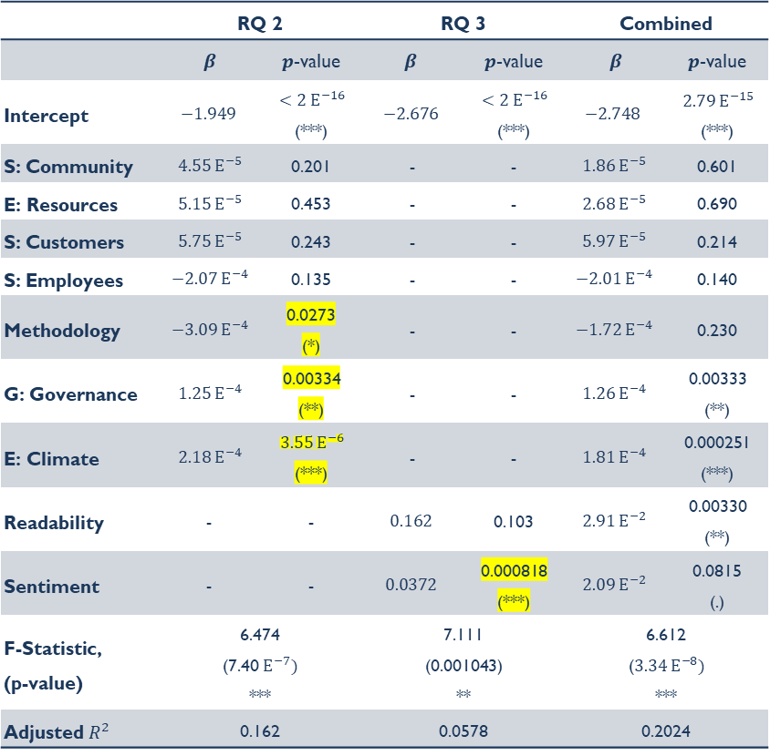
Analysis on Zmijewski Score
What is a sustainability report’s influence on the company’s valuation by investors? [RQ2,3]
The extent of climate and governance disclosures had more positive disclosures have a statistically significant positive relationship with the Zmijewski score.
This is encouraging empirical support for the modern view of the triple bottom line of profits, people, and the planet as a barometer for a company’s success.
This finding is supported by the resource theory and transaction cost economics.
The readability aspect of a sustainability report has the most statistically significant relationship to the Zmijewski score compared to other financial metrics. However, it is still not statistically significant.
 | RQ 2 |  | RQ 3 |  | Combined
 | $$β$$ | $p$-value | $$β$$ | $p$-value | $$β$$ | $p$-value
Intercept | $$−1.949$$ | $$<2 Ε^{−16}$$ (***) | $$−2.676$$ | $$<2 Ε^{−16}$$ (***) | $$−2.748$$ | $$2.79 Ε^{−15}$$ (***)
S: Community | $$4.55 Ε^{−5}$$ | 0.201 | - | - | $$1.86 Ε^{−5}$$ | 0.601
E: Resources | $$5.15 Ε^{−5}$$ | 0.453 | - | - | $$2.68 Ε^{−5}$$ | 0.690
S: Customers | $$5.75 Ε^{−5}$$ | 0.243 | - | - | $$5.97 Ε^{−5}$$ | 0.214
S: Employees | $$−2.07 Ε^{−4}$$ | 0.135 | - | - | $$−2.01 Ε^{−4}$$ | 0.140
Methodology | $$−3.09 Ε^{−4}$$ | 0.0273 (*) | - | - | $$−1.72 Ε^{−4}$$ | 0.230
G: Governance | $$1.25 Ε^{−4}$$ | 0.00334 (**) | - | - | $$1.26 Ε^{−4}$$ | 0.00333 (**)
E: Climate | $$2.18 Ε^{−4}$$ | $$3.55 Ε^{−6}$$ (***) | - | - | $$1.81 Ε^{−4}$$ | 0.000251 (***)
Readability | - | - | $$0.162$$ | 0.103 | $$2.91 Ε^{−2}$$ | 0.00330 (**)
Sentiment | - | - | $$0.0372$$ | 0.000818 (***) | $$2.09 Ε^{−2}$$ | 0.0815 (.)
F-Statistic, (p-value) | 6.474 (7.40$Ε^{−7})$ *** |  | 7.111 (0.001043) ** |  | 6.612 ($3.34 Ε^{−8})$ ***
Adjusted $R^{2}$ | 0.162 |  | 0.0578 |  | 0.2024
Notes:
Findings and discussions – In your research, what were the key deductions that you came upon?

Slide 21
Comparison with Prior Studies
What are the similarities and differences with these findings? [RQ4]
 | Tsang (1998) | Loh et al. (2017)
Methodology | Analysed disclosures from 1986 to 1995 (prior to sustainability disclosures being mandated for listed companies). | Used the Ohlson’s model to investigate the relationship between a sustainability reporting score and the market value.
Similarities |  | Both studies evidence statistically significant positive relationships between the extent and quality of sustainability disclosures and the company’s market value four months after the disclosure date.
Differences | In Tsang (1998), from 1986 to 1995, community-related disclosures were more prominent than environmental disclosures. (5.37% of sentences for climate vs. 0.24% of sentences about environmental-related disclosures). This is vastly different in 2021, where environmental disclosures are more than twice in proportion to community-related disclosures. (~35% of sustainability reports on environmental-related disclosures vs. 15% for community-related disclosures) | This study showed more specifically which topics had impacts on the market value of a company – methodology (+), community (+), and resources (-). Whereas the others did not evidence a statistically significant relationship.
Notes:
Findings and discussions – In your research, what were the key deductions that you came upon?

Slide 22
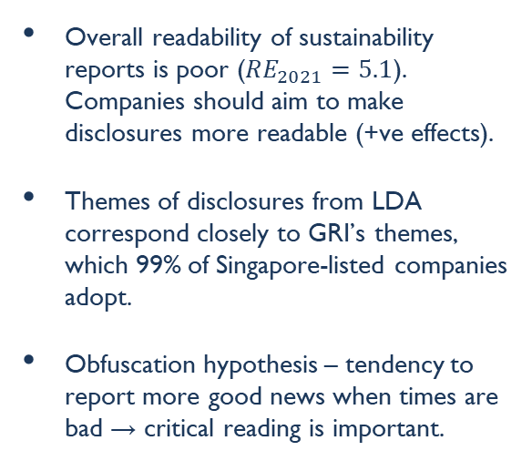
Conclusion
Summing up: What was found, and what next?
Business Environment
CSR & CFP
General Insights
Regulatory bodies are increasingly requiring sustainability disclosures – e.g. Corporate Sustainability Reporting Directive (CSRD) from the EU Parliament, passed on 10 Nov 2022.
More guidance from ISSB and TFCD on standardisation expected (e.g. metrics, disclosure components)
Electronic disclosures is the way forward – e.g. ESGenome (in Singapore), European Single Electronic Format (ESEF) from the CSRD in EU.
Evolution of approach towards CSR and ESG – from an “obligation” to “competitive advantage”.
In a Singapore context:
Extent of community disclosures is positively related with ROA.
Extent of community & methodology disclosures are positively related with Market Value.
This result can be a gauge of what topics are important to different stakeholders.
Overall readability of sustainability reports is poor ($RE_{2021}=5.1$). Companies should aim to make disclosures more readable (+ve effects).
Themes of disclosures from LDA correspond closely to GRI’s themes, which 99% of Singapore-listed companies adopt.
Obfuscation hypothesis – tendency to report more good news when times are bad → critical reading is important.
Notes:
Implications, limitations, suggestions, and conclusion – Here, you have to exhaust the setbacks you encountered during the study, the consequences that your target audience will face if they do not follow the deductions, and then finally sum up the discussions.

Slide 23
Limitations and Future Research
What are some opportunities for further studies?
Industry differentiation:
Rodgers et al. (2013) and Loh et al. (2017) considers differences between industries, or characteristics of the companies (e.g. Government-Linked, Family Businesses, and others)
Without limiting the scope to companies on the STI, a wider sample can be considered for the study to look at all companies listed on the SGX.
Time-series comparison:
All reports (from 2015 to 2021) were treated as within the same sample space.
More regulations were introduced progressively from 2016 by SGX – from mandatory sustainability reporting, to climate reports, and adopting the TCFD’s recommendations. It is worth investigating the differences segregated by year.
Influencing factors on market value:
This study has identified statistically significant relationships between the extent of methodology (+), community (+), and resources (-) disclosures and a company’s market value, and leaves room for investigating further into why this is so.
A qualitative study on the perception of Singapore’s retail and institutional investors will be beneficial for understanding this relationship.
Causality:
Correlation is not causation – this study shows a statistically significant relationship but does not study causation.
There is a possibility to update the conceptual framework proposed in Richardson et al. (1999) with controlled studies.
Notes:
Implications, limitations, suggestions, and conclusion – Here, you have to exhaust the setbacks you encountered during the study, the consequences that your target audience will face if they do not follow the deductions, and then finally sum up the discussions.

Slide 24
A Natural Language Processing Analysis of Sustainability Reports and its Relationship with Corporate Financial Performance: Empirical Evidence from Singapore’s Listed Companies
Jeremy Chia
ESCP Business School
MSc Big Data and Business Analytics, 2021/2022
Supervised by:
Associate Professor Man Ching Gladie LUI
ESCP Business School
Financial Reporting & Audit

Slide 25
Comparison with Prior Studies
What are the similarities and differences with these findings? [RQ4]
Tsang (1998):
Analysed disclosures from 1986 to 1995 (prior to sustainability disclosures being mandated for listed companies).
In Tsang (1998), from 1986 to 1995, community-related disclosures were more prominent than environmental disclosures. (5.37% of sentences for climate vs. 0.24% of sentences about environmental-related disclosures).
This is vastly different in 2021, where environmental disclosures are more than twice in proportion to community-related disclosures. (~35% of sustainability reports on environmental-related disclosures vs. 15% for community-related disclosures)
Loh et al. (2017):
Used the Ohlson’s model to investigate the relationship between a sustainability reporting score and the market value.
Both studies evidence statistically significant positive relationships between the extent and quality of sustainability disclosures and the company’s market value four months after the disclosure date.
In this study showed more specifically which topics had impacts on the market value of a company – methodology (+), community (+), and resources (-). Whereas the others did not evidence a statistically significant relationship.
Notes:
Findings and discussions – In your research, what were the key deductions that you came upon?

